Slide 1

FPT SOFTWARE
WCM (dSPACE) 24/02/2010

Slide 2
Objectives
Go through the list of common features of Notes applications
Introduce the application migration scenarios from Notes to SharePoint
Introduce FPT’s SharePoint Framework 2007 for Notes Migration
Further discussion regarding the presented information

Slide 3
Agenda
Notes Common Features
Notes to SharePoint Migration Scenarios
FPT’s SharePoint Framework 2007 for Notes Migration
Further Discussion

Slide 4
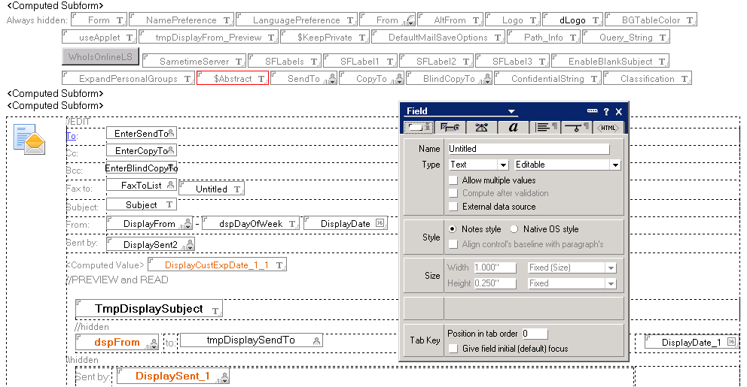
Notes Form

Slide 5
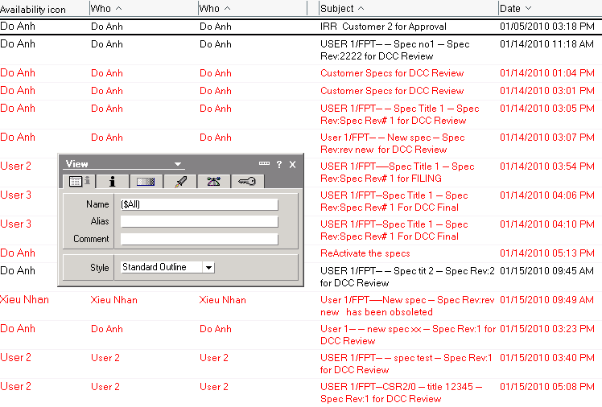
Notes View

Slide 6
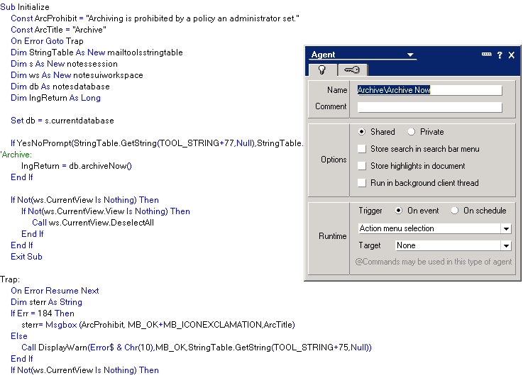
Notes Agent

Slide 7
Agenda
Notes Common Features
Notes to SharePoint Migration Scenarios
FPT’s SharePoint Framework 2007 for Notes Migration
Further Discussion

Slide 8
Migration Obstacles
Form complexity
  Many Lotus Notes controls with specific UI requirements
    Section
    Dialog List
    Multiple Attachment
    etc.
  Robust Lotus Notes ACL (Access Control List) with custom permissions which can control field’s visibility and be utilized in many places.
  Complex implementation model which can inject developer’s code into various design elements, customization code can be scattered everywhere.
View complexity
  Multiple level of “group by” (32 levels)
Agent complexity
  Powerful scripting language which can interact with other Notes applications, Notes databases and external systems (SAP, Oracle, etc.)

Slide 9
Migration Scenarios
Collaboration
  Straight forward with minor interface customizations and data migration only
Forms
  Simple Forms
    Simple UI and logic, only CRUD
  Complex Forms
    Complex UI with complex/simple logic
  In-between Forms
    Simple UI with complex logic
Views
  Simple Views
    Data columns only
  Complex Views
    More than two levels of “group by”

Slide 10
Agenda
Notes Common Features
Notes to SharePoint Migration Scenarios
FPT’s SharePoint Framework 2007 for Notes Migration
Further Discussion

Slide 11
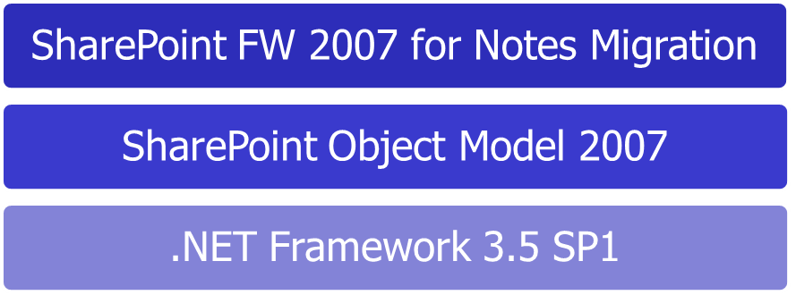
Framework Introduction
Objectives
  Address Notes to SharePoint 2007 migration obstacles
  Reduce the development efforts
  Standardize and enforce the coding best practices
Based entirely on SharePoint Object Model 2007 & .NET Framework 3.5 SP1
Target the medium/complex migration scenarios from Lotus Notes to SharePoint 2007
Deployed to GAC, can be reused at the scope of site collection

Slide 12
Framework Features
ContainerPart
  Loads ASCX controls dynamically (from ControlTemplates folder)
  Configurable using SharePoint “Edit Page”/SharePoint Designer
Common UI Controls
  Wraps SharePoint/.NET controls, provides additional Notes specific UI features
    Multiple level of “group by” in views, multiple attachments, collapsible panel, etc.
  Automatic load/save support to SharePoint list
  SharePoint list data binding for non SharePoint controls
  Form rendering control with custom OK/Cancel event handlers
Common Helpers
  Security
  CAML
  Mail, Logging, etc.
ASCX Generator Tool
  Generates ASCX SharePoint form layout based on SharePoint list definition
  100% compatible with the exclusive usage of SharePoint style sheets (core.css, etc.)
Business Logic/Data Model (Implement or not?)
Scheduled Agents (Timer Jobs with additional support from FW?)
Solution Package/Deployment (Reuse WSPBuilder or implement in FW?)

Slide 13
Framework Utilization
Collaboration
Forms
  Simple Forms
  Complex Forms
    Framework ContainerPart to host custom ASCX files
    Framework Common UI Controls to support Notes specific UI requirements
    C# code with Framework Helper Classes to control logic
    ASCX Generator Tool
  In-between Forms
    Framework Form Rendering Control with custom event handlers
    C# code with Framework Helper Classes to control logic
Views
  Simple Views
  Complex Views
    Framework View Control

Slide 14
Agenda
Notes Common Features
Notes to SharePoint Migration Scenarios
FPT’s SharePoint Framework 2007 for Notes Migration
Further Discussion
Q&A

Slide 15
Thank You!
giangthb@fsoft.com.vn

